Slide 1



MS Access
Class VIII
lab 28

Slide 2

Parameter Queries
you can save and run the same query again and again, but when you run the same query again and again by only changing the criteria then you might consider the query to accept parameters

Slide 3
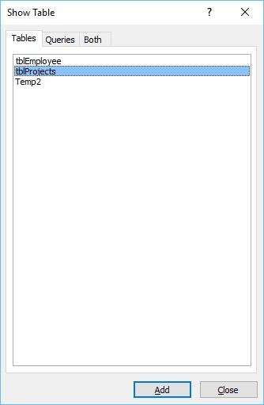
Example
Double-click on the tblProjects and close the Show dialog box

Slide 4
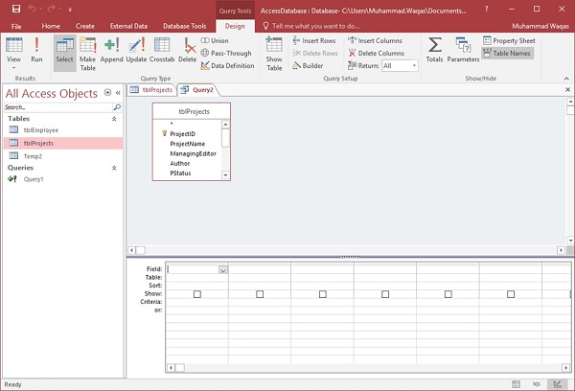
Example

Slide 5
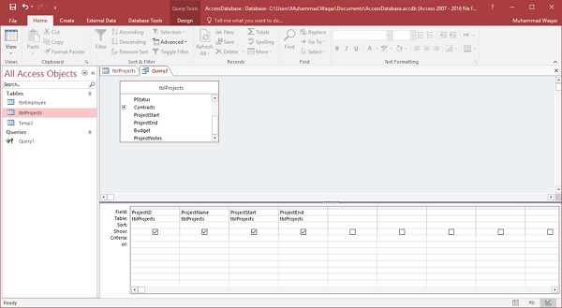
Example
Select the field you want to see as a query result as shown in the following screenshot

Slide 6
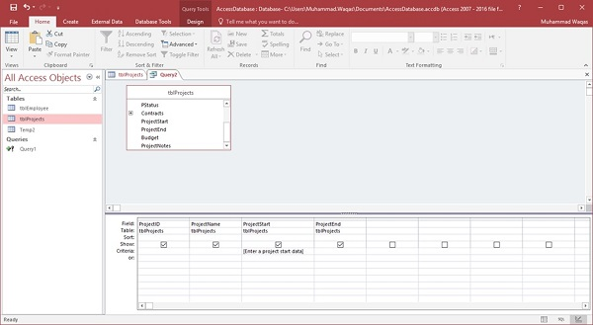
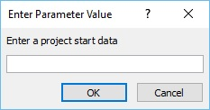
Example
run your query and you will see the following prompt

Slide 7
Example
run your query and you will see the following prompt

Slide 8
Alternate Criteria
You can save and run the same query again and again, and a lot of times you want to add alternate criteria

Slide 9



